Slide 1
Library Management System (python)
Singireddy Harshitha

Slide 2
This problem aims to create a basic library management system that allows users (students or readers) to borrow and return books.
Allow the user to view available books.
Borrow books if available
Return borrowed books
Handle exceptions, such as attempting to return a book that wasn’t borrowed or borrowing a book that doesn’t exist.

Slide 3
Project Requirements:
Use of loops and conditions to manage interactions.
Functions for handling borrowing, returning, and displaying books.
Exception handling for invalid inputs.
Object-oriented programming(OOP) to model the library, books, and users.
Use of modules to structure code.

Slide 4
Logic Explanation: 1.library.py(file)
Manages the books in the library using a list and keeps track of borrowed books using a dictionary.
The display_books method shows all available books.
The borrow_book method checks if the requested book is available and assigns it to the user.
The return_book method ensures the user who borrowed the book returns it.

Slide 5
2.main.py(file)
Imports the library class from library.py.
Creates a user object to interact with the library.
Displays a menu inside a while loop for continuous user interactions.
1. View available books
2. Borrow a book
3. Return a book
4. Exit the system
Handles user input conditional statements(if-elif-else).
Calls functions from the library class for viewing, borrowing, and returning books.

Slide 6
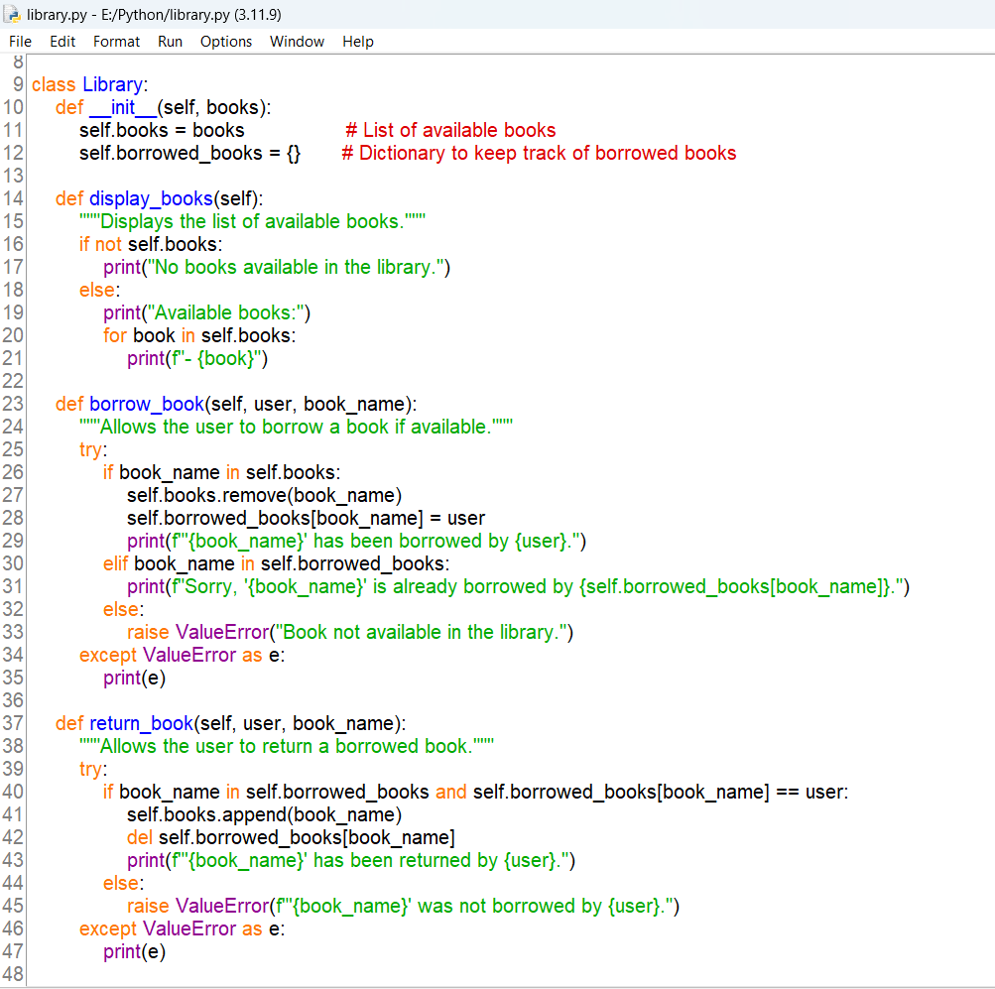
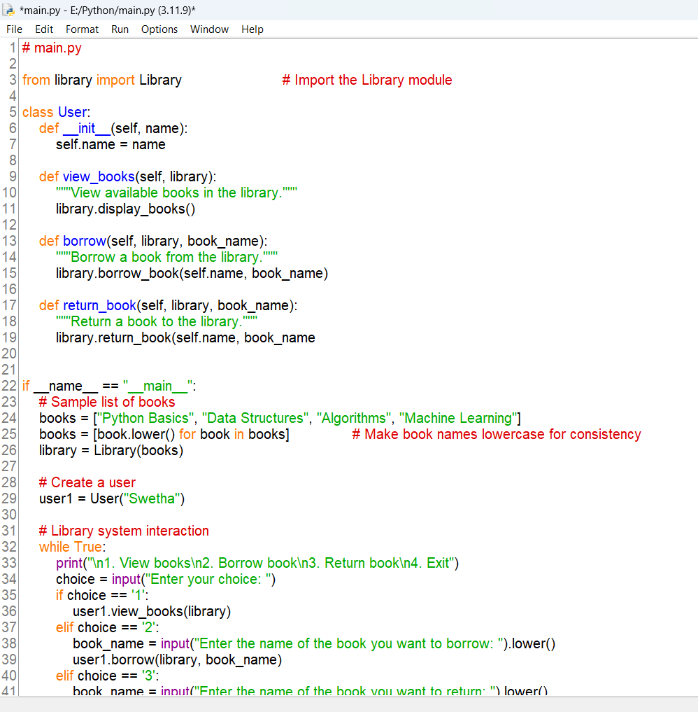

Slide 7
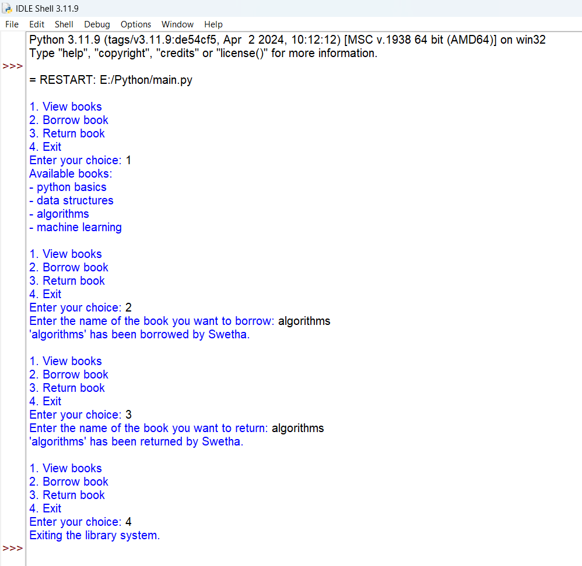
Output/Result:

Slide 8


